Slide 1

Machine Learning Classifiers for Financial Trading Strategies
This project explores the implementation of machine learning classifiers to predict stock trading signals using historical financial data. The goal is to develop and evaluate two distinct trading strategies using various ML classification algorithms. We'll collect and preprocess stock price data, engineer relevant features, and train models to generate buy or sell recommendations for securities.
Kalpavruksha, Rohan Niranjan
Jangareddi, Paul Rohit
Jadhav, Poonam
Gummadi, Sri Harshitha

Slide 2




Machine Learning Classifier Models
We implement three different machine learning classifiers to predict buy/sell signals based on our engineered features:
K-Nearest Neighbors (KNN)
A non-parametric method that classifies based on the majority class of its k nearest neighbors.
Random Forest Classifier (RF)
An ensemble learning method that constructs multiple decision trees and outputs the mode of their predictions.
Gradient Boosting Classifier (GB)
An ensemble technique that builds trees sequentially, with each tree correcting errors from the previous ones.

Slide 3
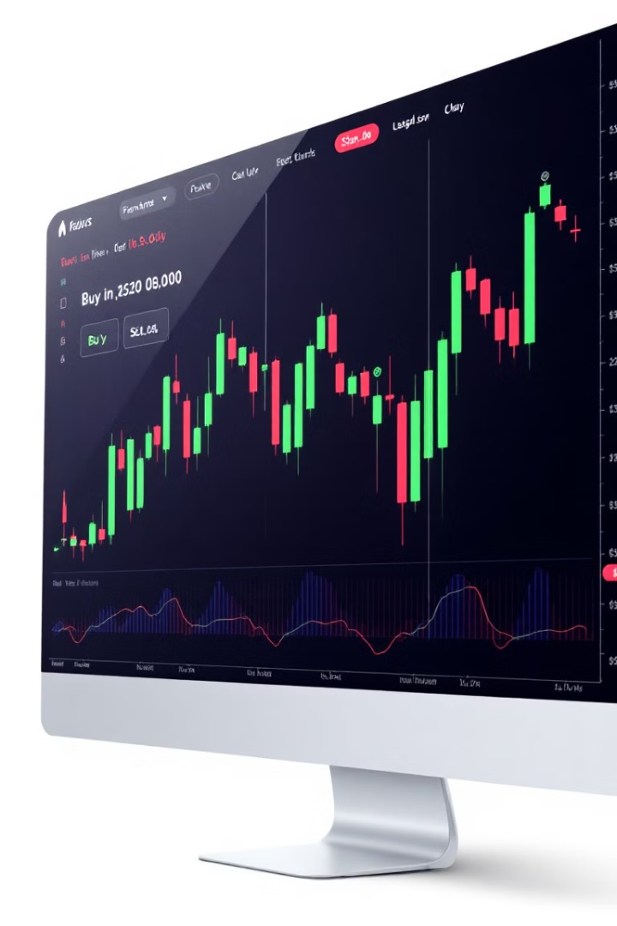
Trading Strategy 1: Next Day Price Comparison
Our first trading strategy compares the next trading day's close price to today's close price. If tomorrow's close is higher, we generate a buy signal (+1). Otherwise, we generate a sell signal (-1). This strategy aims to capture short-term price movements. We implement this using NumPy's functionality:
Signal Generation
y = np.where(df['Stock_Price'].shift(-1) > df['Stock_Price'], 1, -1)
Buy Signal (+1)
Next day's close > Today's close
Sell Signal (-1)
Next day's close ≤ Today's close

Slide 4
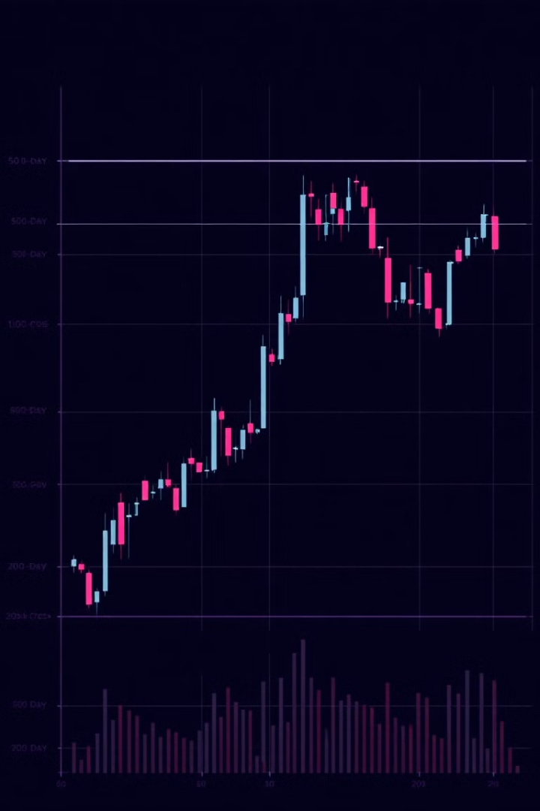



Trading Strategy 2: Moving Average Crossover
The second strategy utilizes the golden cross and death cross concepts based on the 50-day and 200-day moving averages. A golden cross (buy signal) occurs when the 50-day MA crosses above the 200-day MA, indicating a bullish trend. Conversely, a death cross (sell signal) happens when the 50-day MA crosses below the 200-day MA, suggesting a bearish trend.
Calculate MAs
Compute 50-day and 200-day moving averages
Identify Crossovers
Detect when the 50-day MA crosses the 200-day MA
Generate Signals
Assign +1 for golden cross, -1 for death cross

Slide 5

Data Collection and Preprocessing
We begin by collecting historical stock price data using the Yahoo Finance (yfinance) Python library. Our focus is on from 2015 to the end of last year. After downloading the data, we preprocess and clean it to prepare for modeling. Key steps include handling missing values, calculating necessary features like moving averages, and defining our target variables for the two trading strategies.
1
Data Collection
Use yfinance to download historical stock data
2
Data Cleaning
Handle missing values and outliers
3
Feature Engineering
Calculate moving averages and other relevant features
4
Target Definition
Create buy/sell signals for both trading strategies

Slide 6

Model Training and Evaluation Process
For each classifier and trading strategy, we follow these steps:
1
Data Split
Divide the dataset into 80% training and 20% testing sets
2
Model Fitting
Train the classifier on the training data using default parameters
3
Prediction
Generate predictions on the test set
4
Evaluation
Assess model performance using appropriate metrics
We use scikit-learn for KNN, Random Forest and Gradient Boosting.

Slide 7
Implementation in Python
We implement our analysis in a Jupyter Notebook, organizing our code into clear sections for data preprocessing, feature engineering, model training, and evaluation. Here's a sample structure:
Data Preparation
Model Training
Evaluation
Import libraries
Split data
Calculate metrics
Download data
Initialize classifiers
Visualize results
Clean and preprocess
Train models
Compare strategies
Engineer features
Generate predictions
Interpret findings
Define target variables

Slide 8
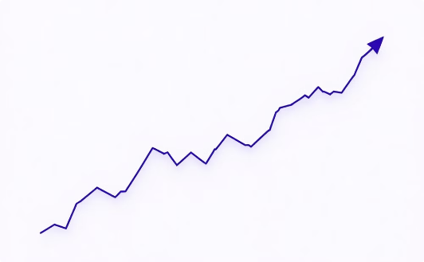
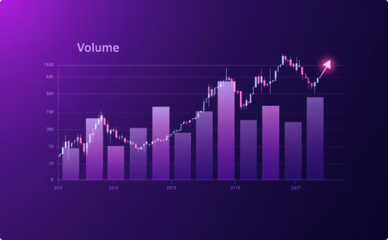
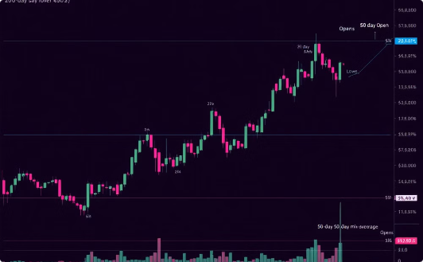
Data Visualization and Analysis
We implement various data visualization techniques to gain insights into our stock data and model performance. Key visualizations include:
Closing Price Over Time
Volume Traded Over Time
Moving Averages
Visualize the stock's price movement throughout the analyzed period.
Analyze trading volume patterns and their relation to price movements.
Plot 20-day and 50-day moving averages to identify trends and potential crossovers.

Slide 9
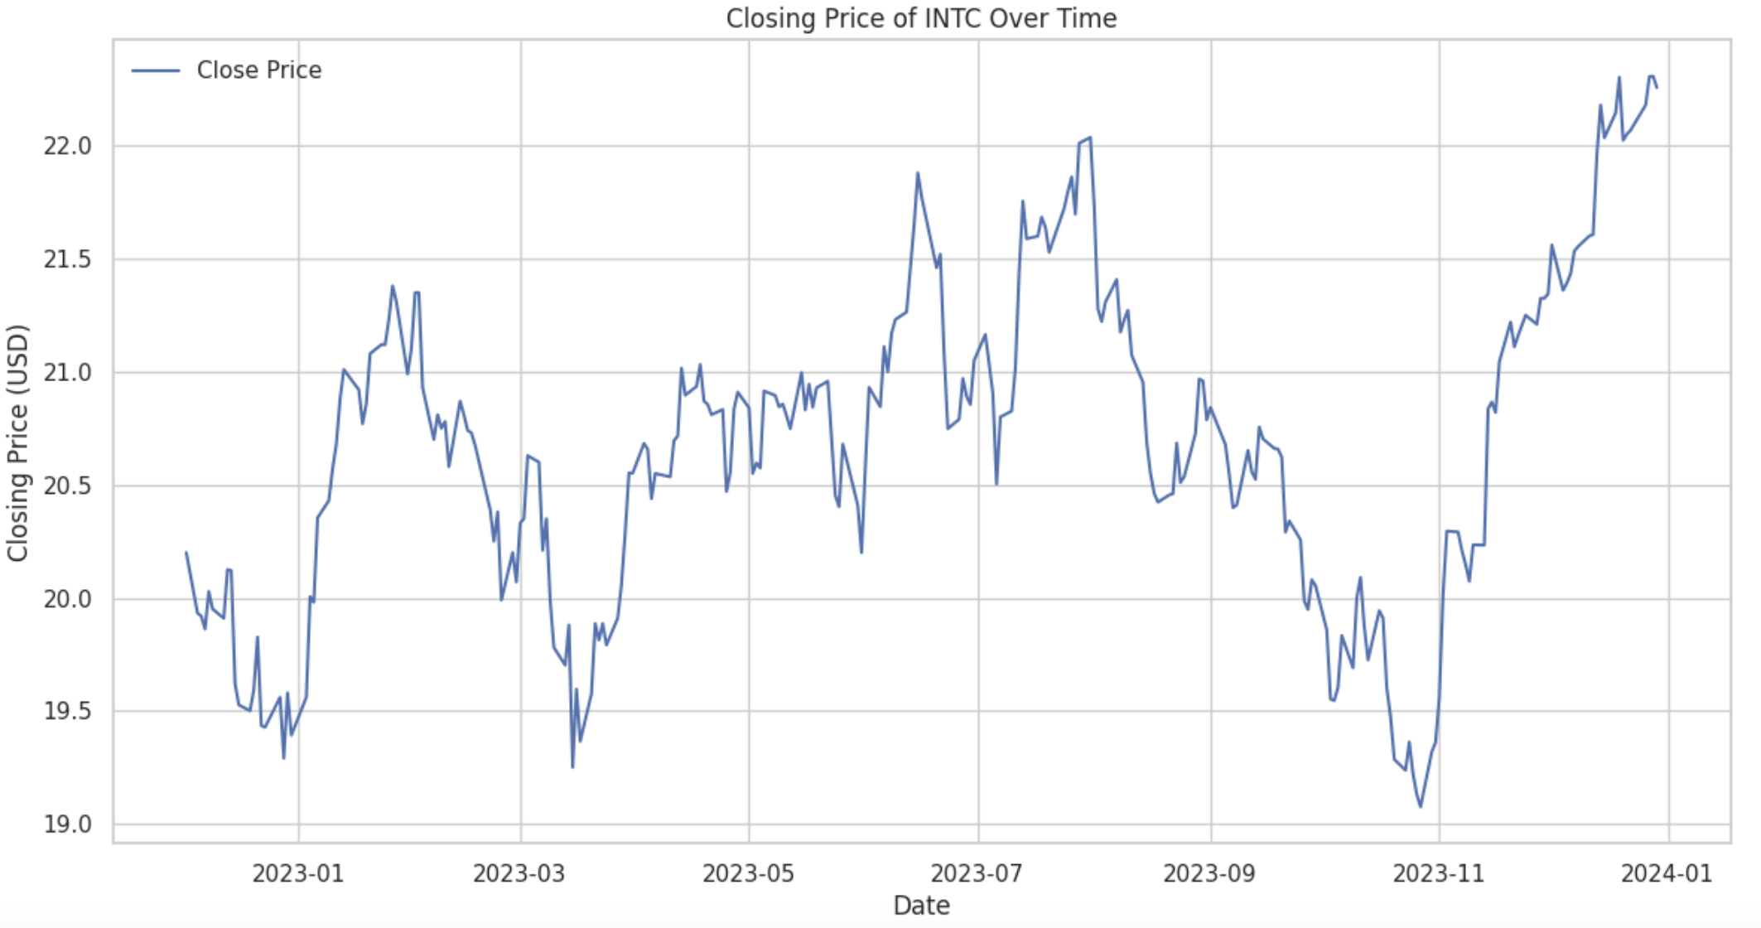
Closing Price Over Time
Intel's stock price showed high volatility in 2023, with a notable drop mid-year. It rebounded strongly towards the end of the year, closing near yearly highs.

Slide 10
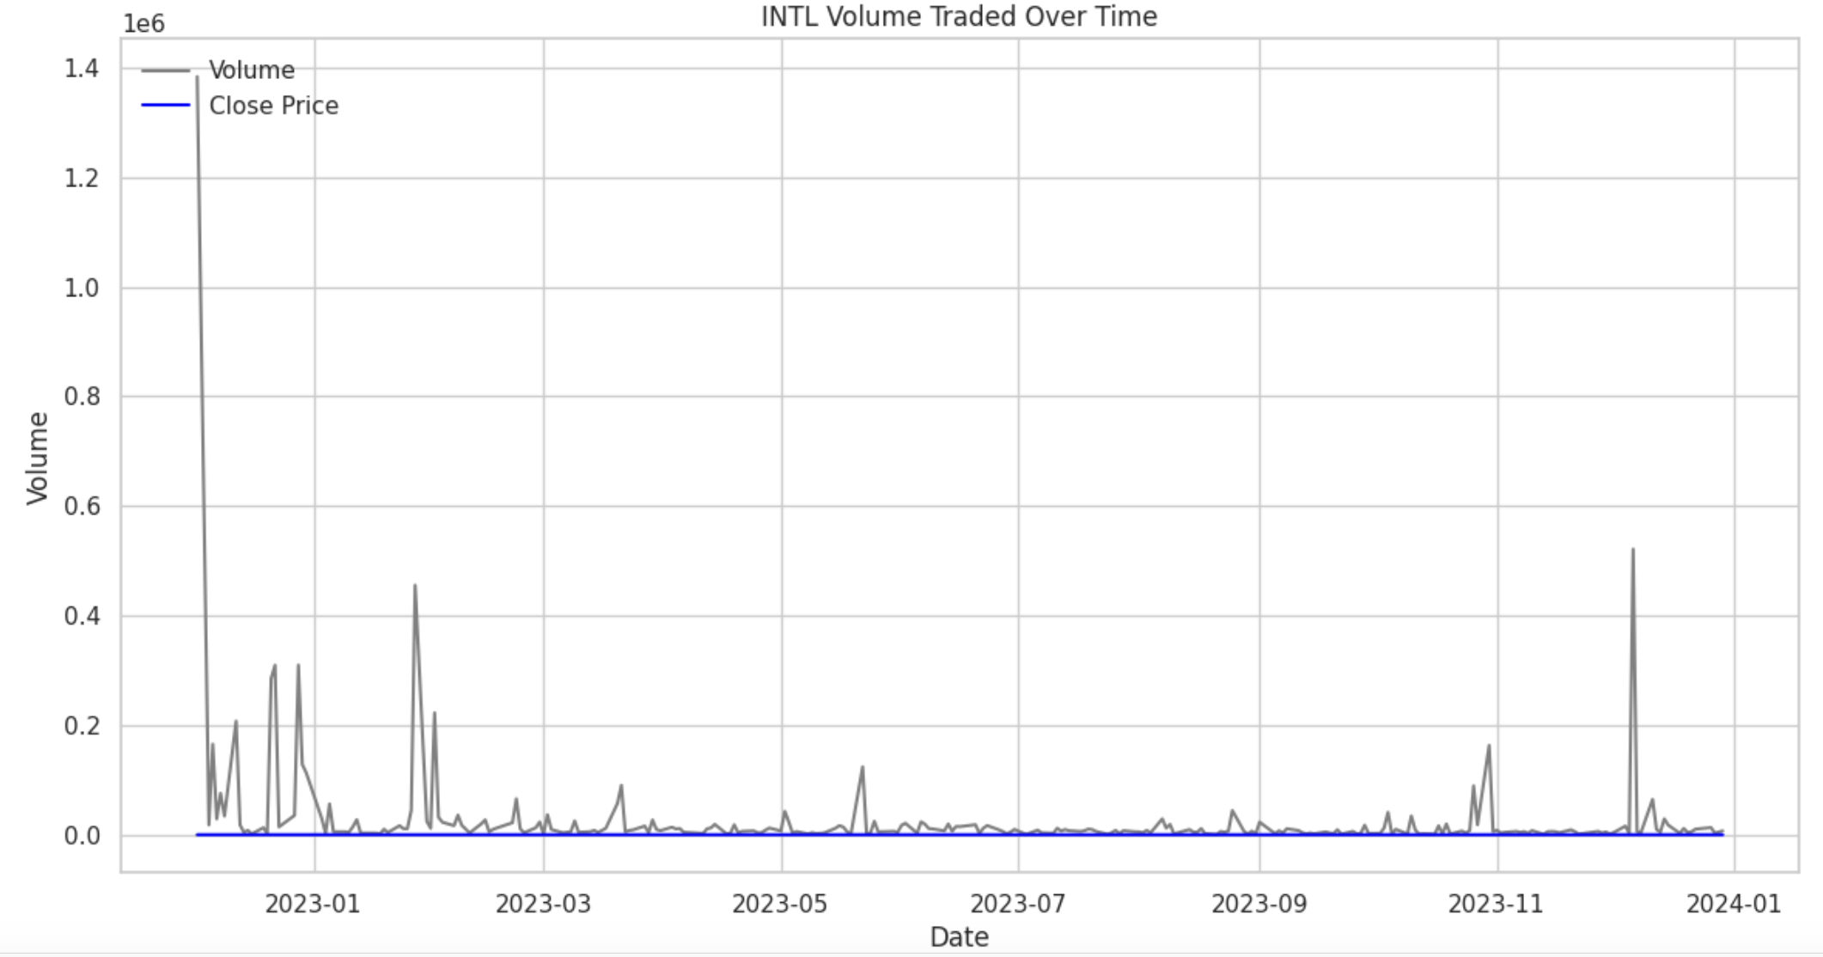
Volume Traded Over Time
The chart shows that INTC's trading volume experienced occasional spikes, particularly at the start and towards the end of the year. These high-volume periods could indicate increased trading activity, likely due to significant events or news affecting the stock.

Slide 11
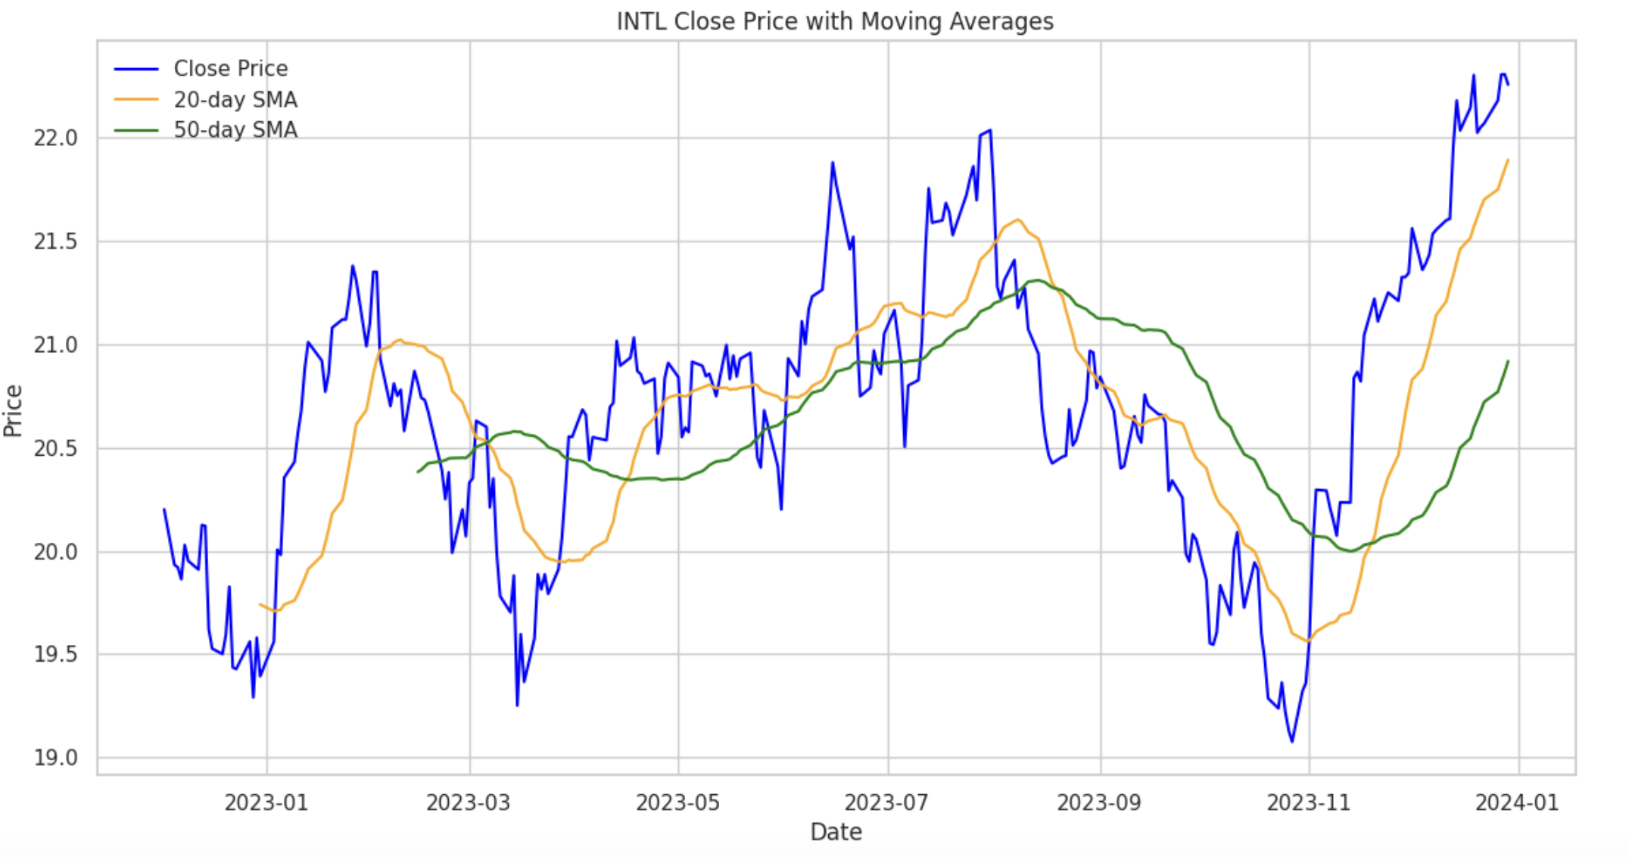
Moving Averages (20-day and 50-day)
The chart shows Intel's (INTC) stock price with 20-day and 50-day Simple Moving Averages (SMAs). The 20-day SMA crossing above the 50-day SMA in late 2023 suggests a bullish trend, indicating potential upward momentum in the stock price.

Slide 12
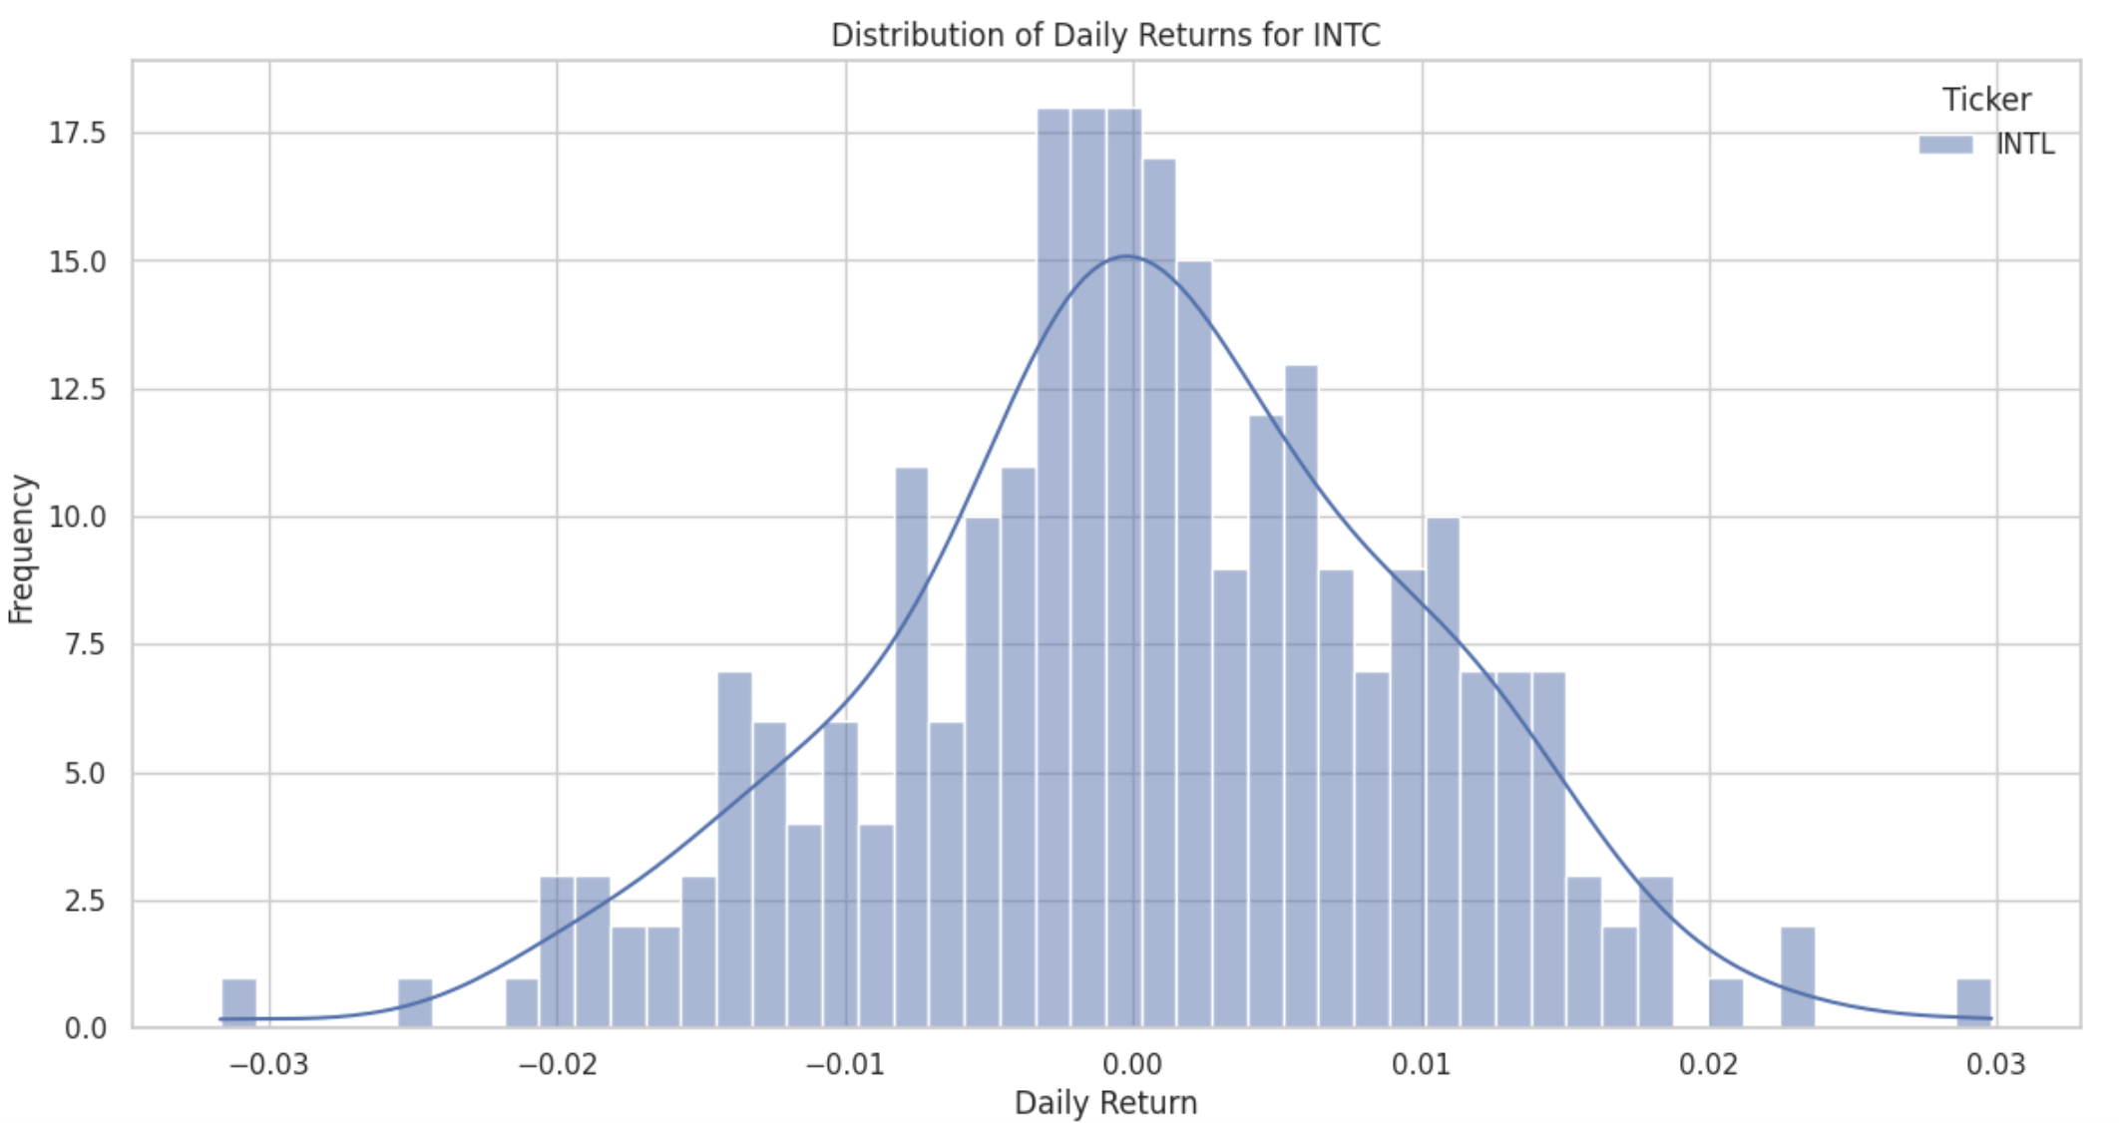
Distribution of Daily Returns
The returns appear to follow a normal distribution centered around zero, indicating that positive and negative returns are roughly balanced. Additionally, most returns lie within the range of -0.02 to 0.02, suggesting low volatility in daily returns.

Slide 13
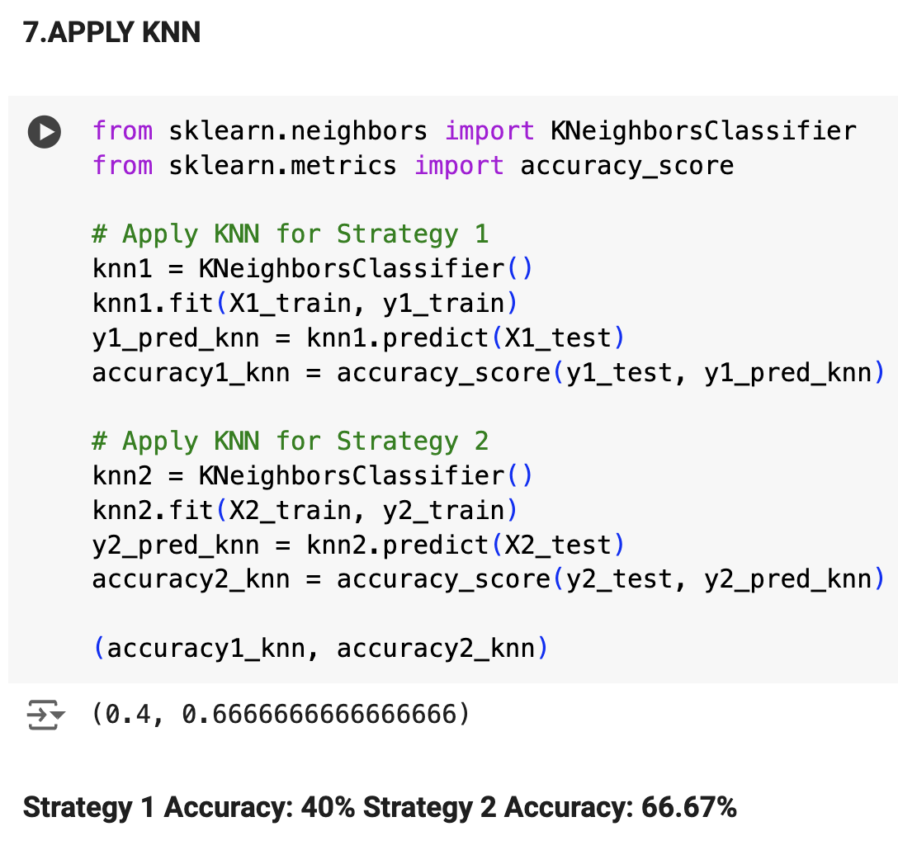
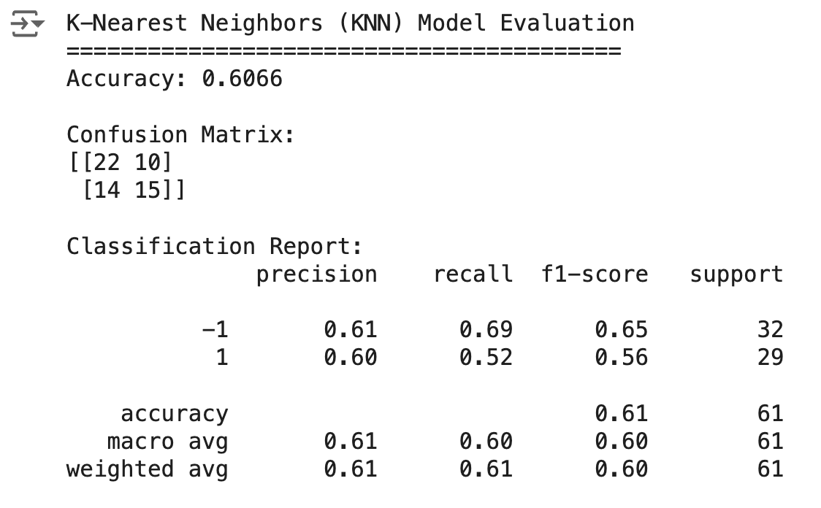
KNN

Slide 14
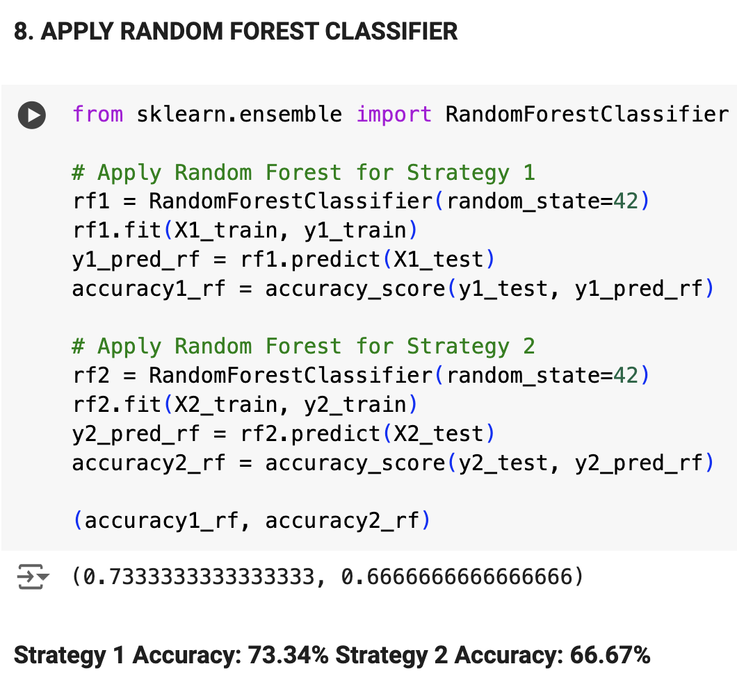
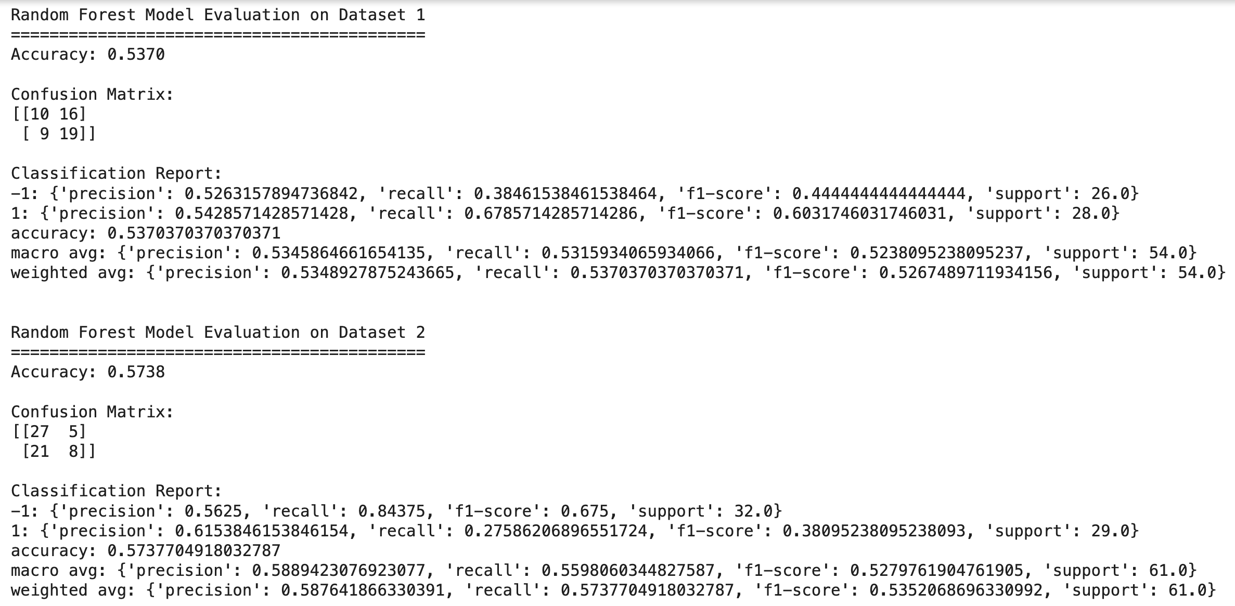
Random Forest

Slide 15
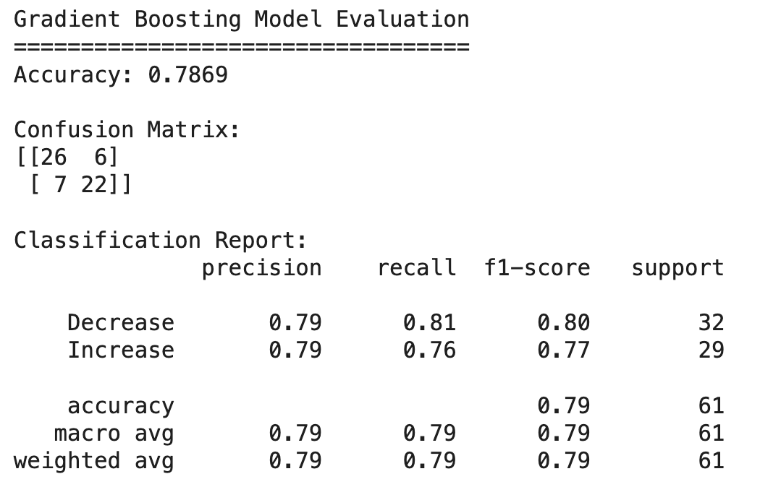
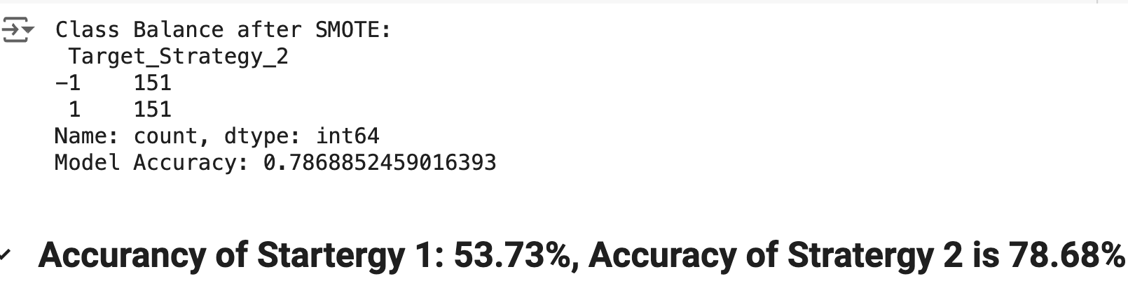
Gradient Boosting

Slide 16

Model Evaluation Conclusion
For Strategy 1, Random Forest is the recommended model due to its strong accuracy. For Strategy 2, XGBoost is the best choice, providing the highest accuracy across all models. These findings suggest that different strategies benefit from different model types, likely due to variations in how each model interprets the feature patterns and interactions within each strategy.
Best Performing Model: Our analysis revealed that the Gradient Boosting Classifier (GB) emerged as the most effective model, delivering the highest accuracy in predicting the future movement of stock prices based on the implemented trading strategies. This underscores the GB model's robustness and its aptitude for capturing complex patterns in financial time series data.
Least Performing Model: The K-Nearest Neighbors (KNN) model, while valuable for its simplicity and ease of interpretation, lagged in performance compared to its counterparts. This highlights the challenges KNN faces in navigating the noisy and non-linear nature of stock market data.
Model Evaluation: Through precision, recall, and F1-score metrics, we gained deeper insights into each model's predictive performance. These evaluations were instrumental in understanding the trade-offs between sensitivity and specificity among the models.

Slide 17

Future Improvements
To enhance our project, we can explore model tuning by adjusting hyperparameters for selected classifiers. This process can potentially improve model performance and provide insights into the sensitivity of our models to different parameter settings. Additional areas for improvement include:
Feature Selection
Identify most impactful features
Hyperparameter Tuning
Optimize model parameters
Time Series CV
Use time-based cross-validation
Backtesting
Simulate trading performance

